Slide 1


Way forward
Reporting under the adapted Governance Regulation
Outlook
Energy Community Annual Meeting
Tallinn | 3 June 2026
© Filip Hrebenda, REDISCOVER Nature / EEA

Slide 2
Key learning
Getting started takes time
Becoming familiar with reporting requirements
Identifying relevant data sources
Learning to use Reportnet and related IT tools
Finding resources to address technical and methodological challenges
Capacity is a key enabler
Contracting Parties need sufficient resources and capacity to fully benefit from support
The initial stages of reporting are the most demanding
Effort typically decreases as familiarity and systems improve over time
© Filip Hrebenda, REDISCOVER Nature / EEA

Slide 3
Key learning
Support needs to be flexible and responsive
Adaptable support formats, tailored to different needs
Drawing on experiences from EU Member States and Contracting Parties
Identifying synergies and coordinating with other projects (e.g. UNEP's CBIT-GSP, TRATOLOW)
Maintaining availability when needed, including informal, ad hoc support
© Filip Hrebenda, REDISCOVER Nature / EEA

Slide 4
2026 workplan (Q3-Q4)
What have we planned?
Planned activities
Preparation of 2027 dataflows and reporting guidelines
Most dataflows open on 15 January and close on 15 March
Webinars on 2027 reporting
Thematic webinars per dataflow or reporting area (mitigation, adaptation, energy, climate finance, GHG inventories)
Webinar on the requirements under the comprehensive review
s
© Filip Hrebenda, REDISCOVER Nature / EEA

Slide 5
2026 workplan (Q3-Q4)
What have we planned?
Planned activities
Regional thematic workshops
GHG Inventory workshop in October/November to prepare for the January 15 submission deadline
Mitigation/Energy/Adaptation workshop(s) in January (to prepare for the 15 March deadline)
National trainings – upon requests
In addition to the regional workshops, we are discussing national workshops with several CPs
s
© Filip Hrebenda, REDISCOVER Nature / EEA

Slide 6
2026 workplan (Q3-Q4)
What have we planned?
Planned activities
Report on ‘National Systems for PaMs and Projections’
Overview of national systems for PaMs and Projection across CPs. The focus on closing the gaps.
Interviews will take place over the summer.
Report on the state of adaptation across Contracting Parties
Based on data reported in the 2025 reporting cycle
Only countries that reported will be covered in the assessment
Continued publication of the reported data
Integration of reported data into EEA's datahub and visualizations of data
Completion of IT tools to transfer data between Reportnet and UNFCCC reporting tools
s
© Filip Hrebenda, REDISCOVER Nature / EEA

Slide 7
2026 workplan (Q3-Q4)
What have we planned?
Planned activities
Continue to develop ‘Working Group’-like structures
To enable technical exchange and facilitate peer learning
To build on existing structures (e.g. the Teams space) and taking the ‘lean teams’ into account
COP 31 Side-event
Showcase the Contracting Parties as ‘Transparency frontrunners’ resulting from the increased reporting under the adapted Governance Regulation
s
© Filip Hrebenda, REDISCOVER Nature / EEA

Slide 8

Take-home messages
Reporting efforts are paying off:
There has been significant improvement
… but many reports are still missing or submitted late
The reporting process is designed for continuous improvement > engagement helps us improve
Peer exchange and sharing of best practices are valuable — reach out to peers for help and to strengthen reporting quality and efficiency
Make full use of the support available from the EEA
© Filip Hrebenda, REDISCOVER Nature / EEA

Slide 9
2027 Comprehensive Review
Review of GHG Inventories under the adapted Governance Regulation
© Filip Hrebenda, REDISCOVER Nature / EEA

Slide 10
Scope
Timeline
EMRT
© Filip Hrebenda, REDISCOVER Nature / EEA

Slide 11
Inventory Review
Scope
Article 38(1) of the adapted Governance Regulation 2018/1999:
“With a view to monitoring Contracting Parties’ greenhouse gas emission reductions or limitation
<…> targets set out in Energy Community law, the Energy Community Secretariat shall, in 2027
and 2032, carry out a comprehensive review of the national inventory data submitted by Contracting
Parties <…>. Contracting Parties shall participate fully in that process.”
© Filip Hrebenda, REDISCOVER Nature / EEA

Slide 12
Review checks
Scope
According to Article 38(2), the review shall include:
Checks to verify the transparency, accuracy, consistency, comparability and completeness of information submitted;
Checks to identify cases where inventory data are prepared in a manner which is inconsistent with UNFCCC guidance documentation or Energy Community rules;
Where appropriate, calculating the resulting technical corrections necessary, in consultation with the Contracting Parties.
© Filip Hrebenda, REDISCOVER Nature / EEA

Slide 13
Targets
Scope
Annex XIV of the adapted Governance Regulation stipulates targets for Net Greenhouse Gas Emissions in 2030.
The targets cover all domestic net GHG emissions, including LULUCF emissions and removals (except for Montenegro).
© Filip Hrebenda, REDISCOVER Nature / EEA

Slide 14
Timeline
Initial checks and Comprehensive Review
Jan
Jun
Aug
May
Feb
Mar
Apr
Jul
Initial Checks
Comprehensive Review
15 Jan
GHGI (x-2)
Gov Reg Art. 26(3)
15 Mar
Final GHGI (x-2)
Gov Reg Art. 26(3)
Annex XXII of Implementing Regulation (EU) 2020/1208
© Filip Hrebenda, REDISCOVER Nature / EEA

Slide 15
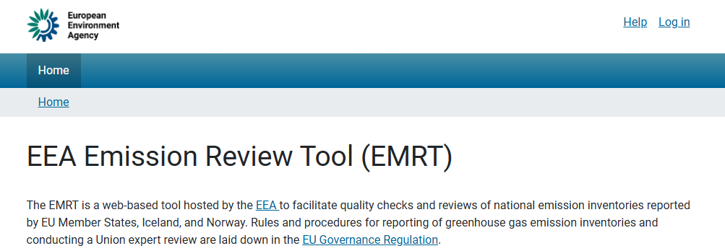
EMRT
Emission Review Tool - EMRT
The Emission Review Tool (EMRT) is used for communication and documentation of review questions and recommendations.
EEA Review Tool — EEA Emission Review Tool (EMRT) (europa.eu)
Access is through an eionet account.
© Filip Hrebenda, REDISCOVER Nature / EEA

Slide 16
CP provide responses to questions
Centralised Review
Potential Technical Corrections
Based on 15 March submissions
CP provide answers to questions and potential technical corrections
Draft Technical Corrections sent to CP
CP respond to Draft Technical Corrections or provide Revised Estimates
TERT compiles draft review reports, and sent to CP
Potential country visits
40 days after draft review report
CP provide comments on draft review reports
75 days after Centralised Review
TERT finalises Review Reports
83 days after Centralised Review
Final Review Reports sent to CP
21 days after Centralised Review
15 days after Centralised Review
1 day after Centralised Review
1 week
1 week
Desk based Review
TERT/EEA
CP
Annex XXII of Implementing Regulation 2020/1208

Slide 17
EMRT - Coordinators
The Coordinator is the officially nominated contact point and is the primary contact point, and
Has greater access in the EMRT;
Receives questions from the EU Team and the TERT via the EMRT;
Collects input from several sector experts, the so-called experts;
Drafts the reply in the EMRT based on input from experts, and
Submits the final reply to the EU Team and the TERT via the EMRT.
Contracting Parties update their nominations for Coordinator and deputy coordinator before the start of the review.
© Filip Hrebenda, REDISCOVER Nature / EEA

Slide 18
EMRT - Experts
The Expert supports the Coordinator in the provision of a reply, and
Has limited access in the EMRT;
Provides comments and/or input to the draft reply if requested by the Coordinator;
Only has access to observations where input has been requested.
Coordinators decide if they want to collect the input and comments from experts inside or outside the EMRT.
The internal commenting loop between Coordinator and experts and the draft reply are not accessible to the EU Team or the TERT – only the final reply submitted by the Coordinator is considered.
Contracting Parties update their nominations for experts before the start of the review.
© Filip Hrebenda, REDISCOVER Nature / EEA

